Slide 1
XQTL analyses - 181026

Slide 2
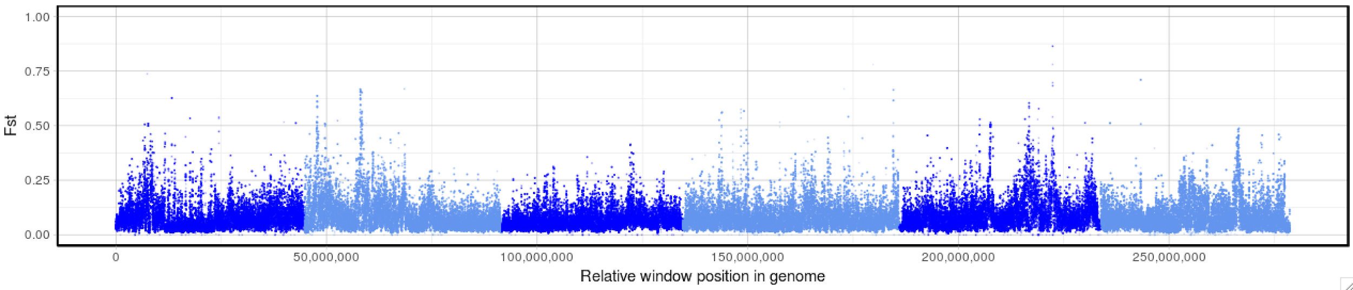
Parent: UGA vs ISE L3_200

Slide 3
Rationale behind choosing genomic window range around a central high Fst peak
PEAK_COORD (manually defined)
Halfway between peak max and genome-wide average Fst
([PEAK_FST + Genome-wide average Fst] /2 )
PEAK_FST
PEAK_START_FST
PEAK_END_FST
Fst
Genome-wide average Fst + 3SD
PEAK_START_COORD
PEAK_END_COORD
PEAK_WINDOW_SIZE
( PEAK_END_COORD - PEAK_START_COORD)

Slide 4
Table is here:
https://docs.google.com/spreadsheets/d/18bdbb_ffpswVvx6ZquYCSl-LeGvuRAWi2oYZXoJdxIw/edit?usp=sharing
XQTL_IVM | CHR | PEAK_COORD | PEAK_FST | PEAK_START_COORD | PEAK_END_COORD | PEAK_WINDOW_SIZE | PEAK_START_FST | PEAK_END_FST
 | hcontortus_chr2_Celeg_TT_arrow_pilon | 2947500 | 0.05130916 | 2887500 | 3097500 | 210000 | 0.04251466 | 0.0393013 | osm-1/che-11
 | hcontortus_chr5_Celeg_TT_arrow_pilon | 33842500 | 0.06678443 | 33842500 | 34197500 | 355000 | 0.06678443 | 0.04673151
 | hcontortus_chr5_Celeg_TT_arrow_pilon | 36317500 | 0.10849596 | 35822500 | 36342500 | 520000 | 0.10612988 | 0.07250467
 | hcontortus_chr5_Celeg_TT_arrow_pilon | 37467500 | 0.07105946 | 37172500 | 37727500 | 555000 | 0.05385728 | 0.05768263 | cky-1
 | hcontortus_chr5_Celeg_TT_arrow_pilon | 45502500 | 0.05457696 | 45502500 | 45897500 | 395000 | 0.05457696 | 0.04164941
 | hcontortus_chr5_Celeg_TT_arrow_pilon | 46717500 | 0.04836741 | 46717500 | 46867500 | 150000 | 0.04836741 | 0.037368
XQTL_LEV | CHR | PEAK_COORD | PEAK_FST | PEAK_START_COORD | PEAK_END_COORD | PEAK_WINDOW_SIZE | PEAK_START_FST | PEAK_END_FST
 | hcontortus_chr4_Celeg_TT_arrow_pilon | 14817500 | 0.07934698 | 14352500 | 15062500 | 710000 | 0.0772273 | 0.06304713 | lev-1
 | hcontortus_chr5_Celeg_TT_arrow_pilon | 22157500 | 0.06093688 | 22152500 | 22387500 | 235000 | 0.06282812 | 0.04983515
 | hcontortus_chr5_Celeg_TT_arrow_pilon | 28482500 | 0.08273666 | 28252500 | 28482500 | 230000 | 0.06915172 | 0.08273666
 | hcontortus_chr5_Celeg_TT_arrow_pilon | 31467500 | 0.10024437 | 31037500 | 31827500 | 790000 | 0.07192149 | 0.09878423 | acr-8
XQTL_BZ | CHR | PEAK_COORD | PEAK_FST | PEAK_START_COORD | PEAK_END_COORD | PEAK_WINDOW_SIZE | PEAK_START_FST | PEAK_END_FST
 | hcontortus_chr1_Celeg_TT_arrow_pilon | 6992500 | 0.09456757 | 6977500 | 7067500 | 90000 | 0.0940999 | 0.08662993 | btub-1
 | hcontortus_chr1_Celeg_TT_arrow_pilon | 8337500 | 0.23776054 | 8327500 | 8812500 | 485000 | 0.24391793 | 0.17494338
 | hcontortus_chr1_Celeg_TT_arrow_pilon | 8807500 | 0.08951118 | 8327500 | 8807500 | 480000 | 0.06096601 | 0.08951118
AI | CHR | PEAK_COORD | PEAK_FST | PEAK_START_COORD | PEAK_END_COORD | PEAK_WINDOW_SIZE | PEAK_START_FST | PEAK_END_FST
 | hcontortus_chr1_Celeg_TT_arrow_pilon | 11047500 | 0.07026732 | 11047500 | 11292500 | 245000 | 0.07026732 | 0.06312572
 | hcontortus_chr2_Celeg_TT_arrow_pilon | 3037500 | 0.07942993 | 2992500 | 3267500 | 275000 | 0.06980073 | 0.07087416
 | hcontortus_chr3_Celeg_TT_arrow_pilon | 38012500 | 0.10238732 | 38012500 | 38057500 | 45000 | 0.10238732 | 0.09090909
DOSE RESPONSE | CHR | PEAK_COORD | PEAK_FST | PEAK_START_COORD | PEAK_END_COORD | PEAK_WINDOW_SIZE | PEAK_START_FST | PEAK_END_FST
 | hcontortus_chr5_Celeg_TT_arrow_pilon | 34052500 | 0.35451348 | 34052500 | 34397500 | 345000 | 0.35451348 | 0.5
XQTL_ADULT | CHR | PEAK_COORD | PEAK_FST | PEAK_START_COORD | PEAK_END_COORD | PEAK_WINDOW_SIZE | PEAK_START_FST | PEAK_END_FST
 | hcontortus_chr2_Celeg_TT_arrow_pilon | 27157500 | 0.128067 | 27087500 | 27237500 | 150000 | 0.09835384 | 0.10921149
 | hcontortus_chr5_Celeg_TT_arrow_pilon | 37377500 | 0.19438392 | 37352500 | 37467500 | 115000 | 0.15285681 | 0.15094016

Slide 5
Peak prediction
- using Fst data only to computationally find putative peaks in data
- attempting to be "objective", rather than cherry-picking by eye
-

Slide 6
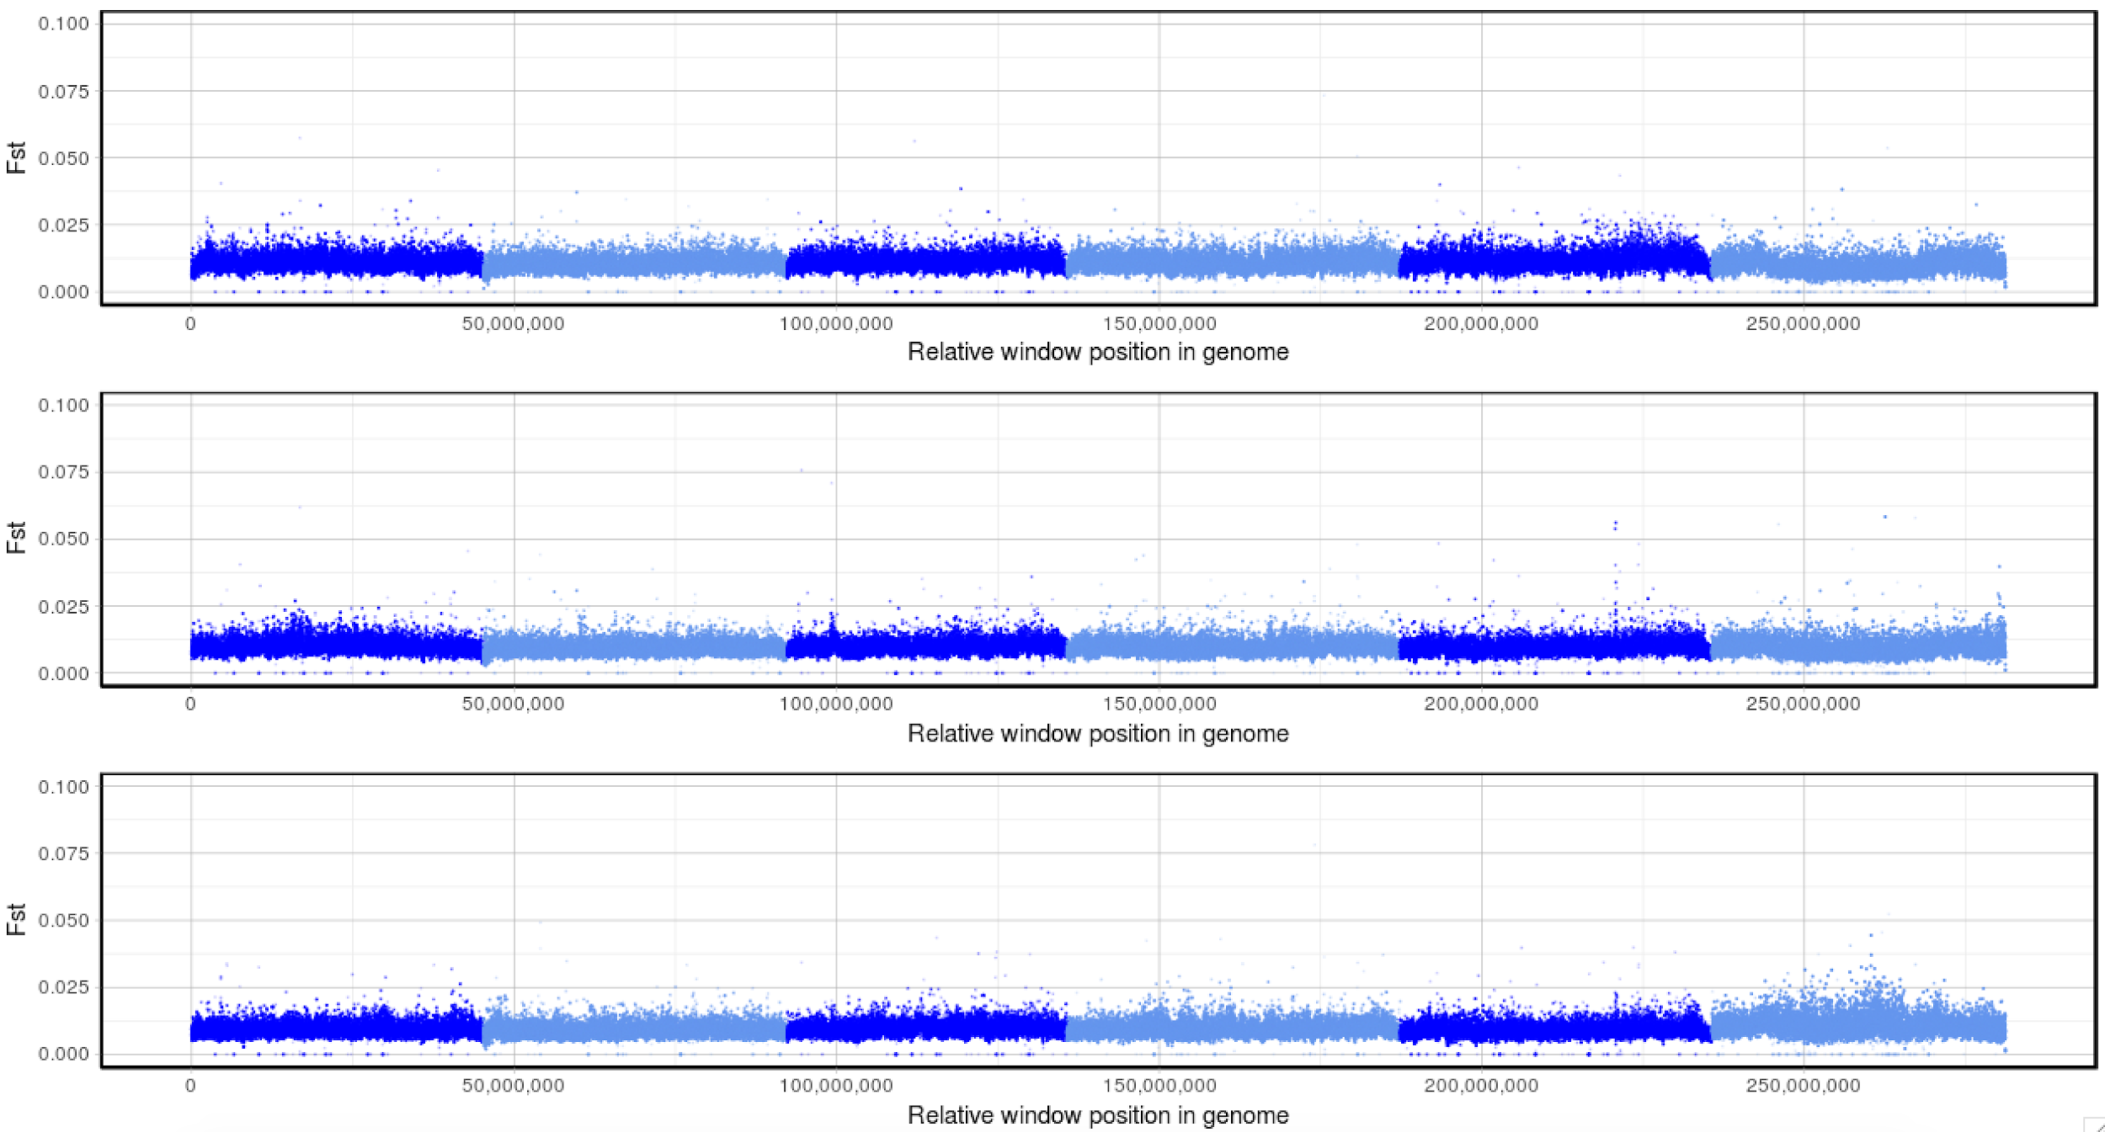
XQTL_control: F3 L3_n200
XQTL_control_R1
XQTL_control_R2
XQTL_control_R3

Slide 7
Peak prediction

Slide 8
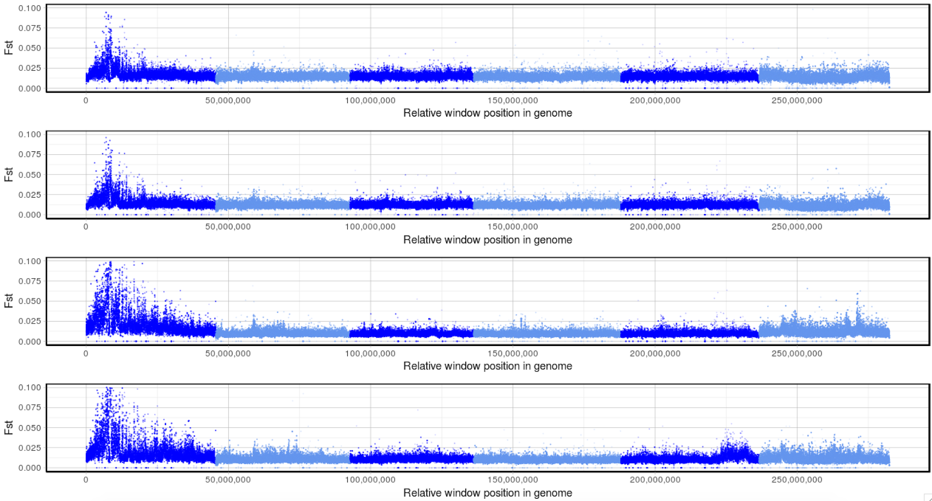
XQTL_BZ: F3 L3_n200
XQTL_BZ_R1.1
XQTL_BZ_R1.2
XQTL_BZ_R2
XQTL_BZ_R3

Slide 9
Peak prediction

Slide 10
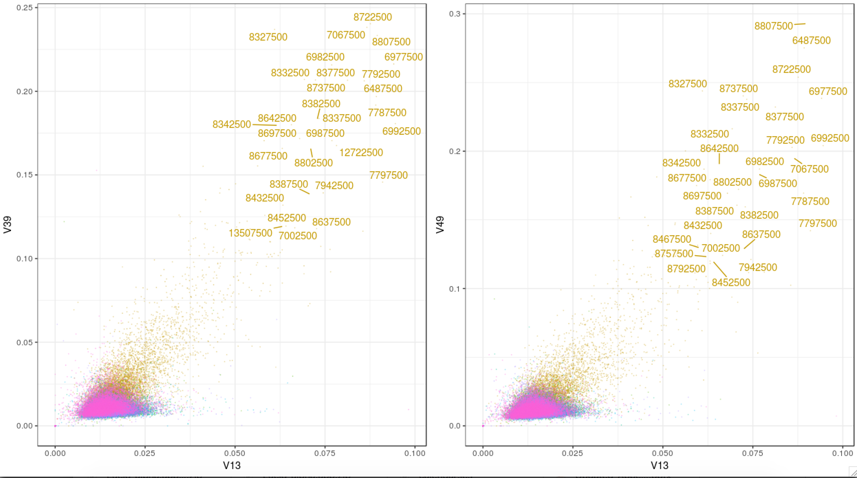
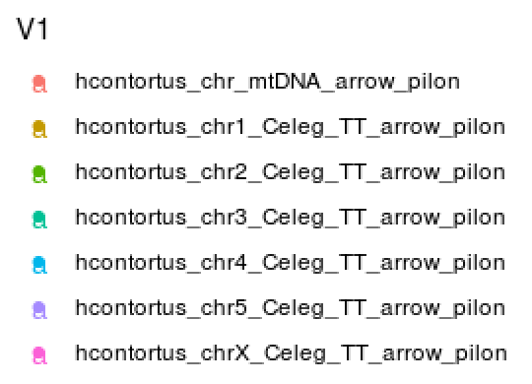
XQTL_BZ: F3 L3_n200 – pairwise between replicates
hcontortus_chr1_Celeg_TT_arrow_pilon:7027492-7031447
#Rep1.1 Rep1.2 Rep2 Rep3
#V13 V27 V39 V49

Slide 11
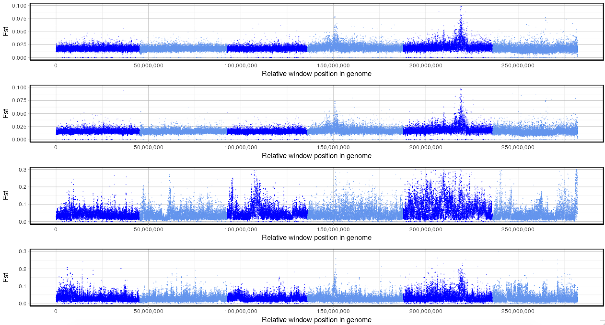
XQTL_LEV: F3 L3_n200
XQTL_LEV_R1.1
XQTL_LEV_R1.2
XQTL_LEV_R2
XQTL_LEV_R3
Note: Fst scale of bottom two plots is different

Slide 12
Peak prediction

Slide 13
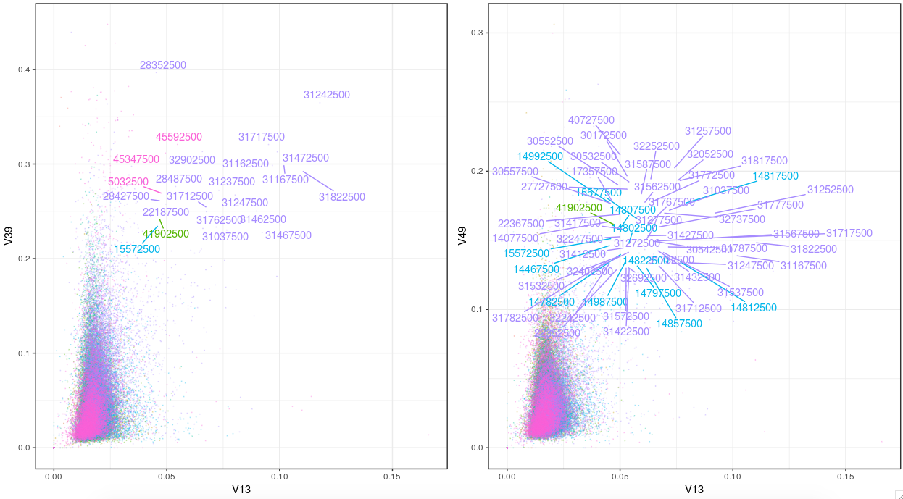
XQTL_LEV: F3 L3_n200 – pairwise between replicates
#Rep1.1 Rep1.2 Rep2 Rep3
#V13 V27 V39 V49

Slide 14
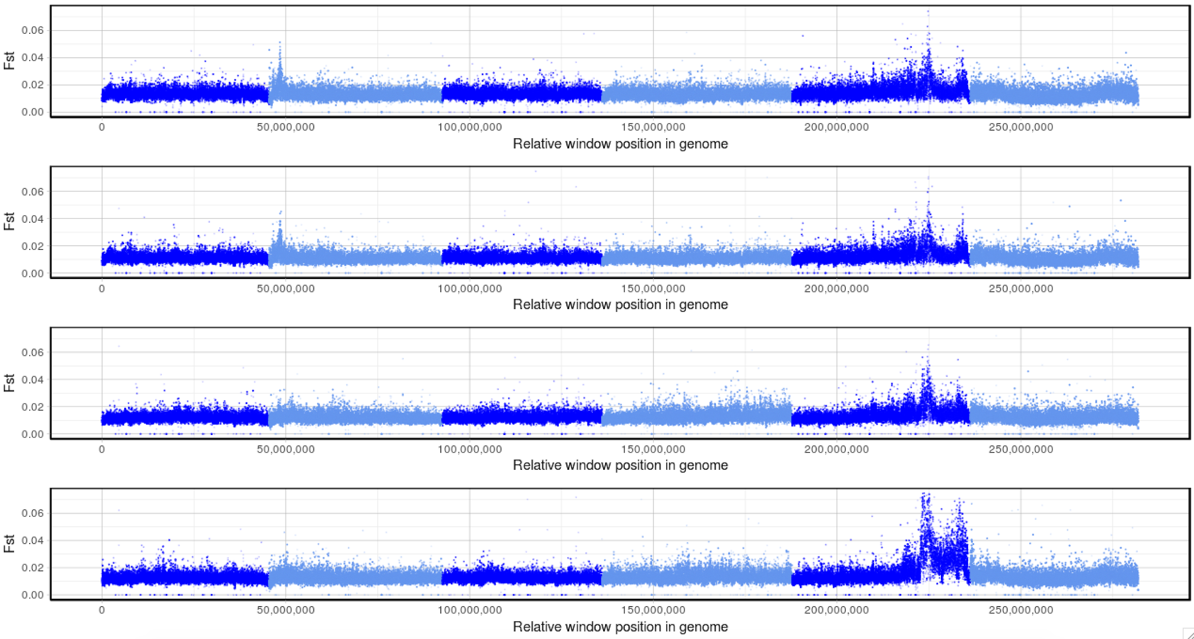
XQTL_IVM: F3 L3_n200
XQTL_IVM_R1.1
XQTL_IVM_R1.2
XQTL_IVM_R2
XQTL_IVM_R3

Slide 15
Peak prediction

Slide 16
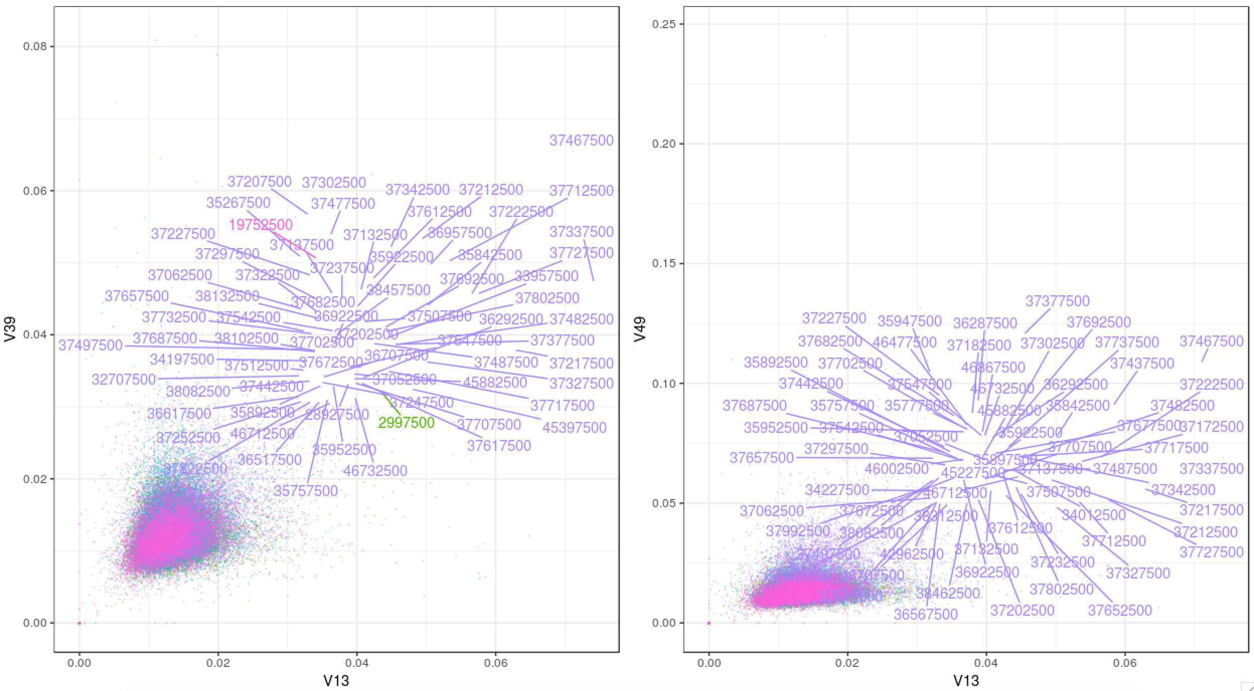
XQTL_IVM: F3 L3_n200 – pairwise between replicates

Slide 17
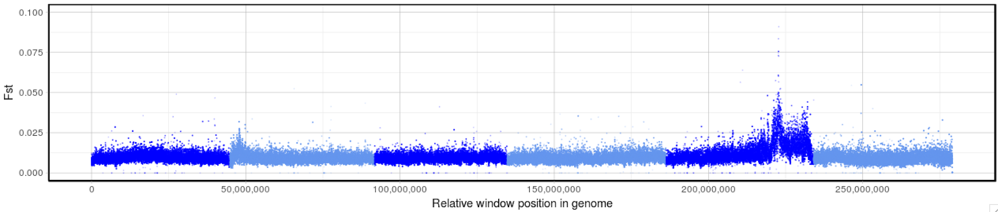
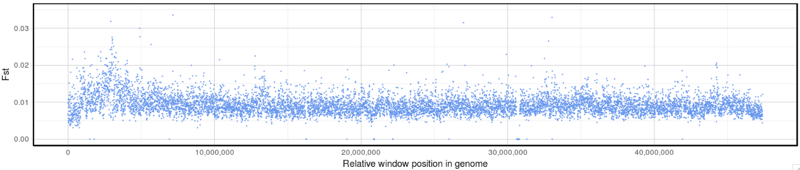
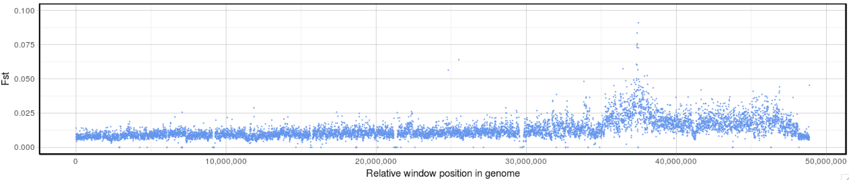
XQTL_IVM: F3 L3_n5000
Chr II
Chr V
Note: Fst scale of top plot is 1/10th of parents

Slide 18
Peak prediction

Slide 19
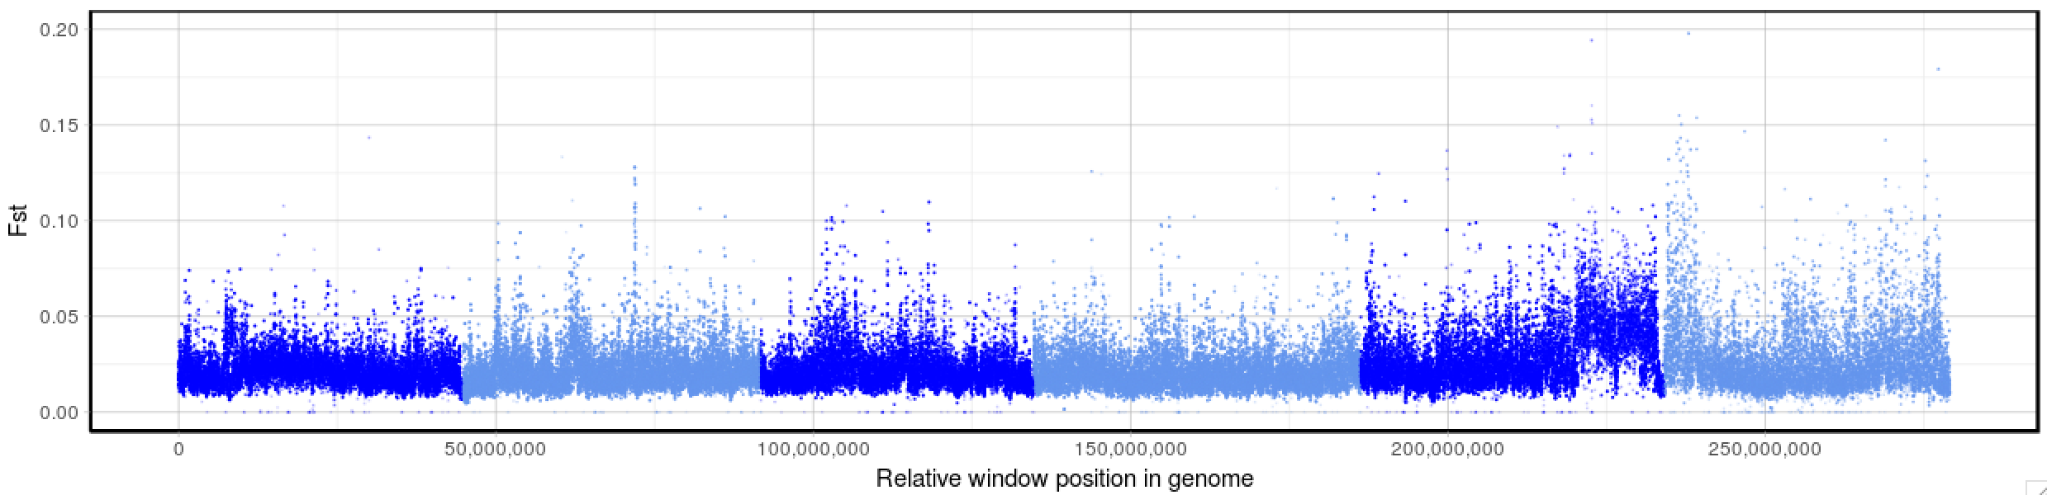
XQTL_IVM: F2 AdultM_n40
AdultM
L3_5000
Note: Fst scale of adults is double of L3

Slide 20
Peak prediction

Slide 21
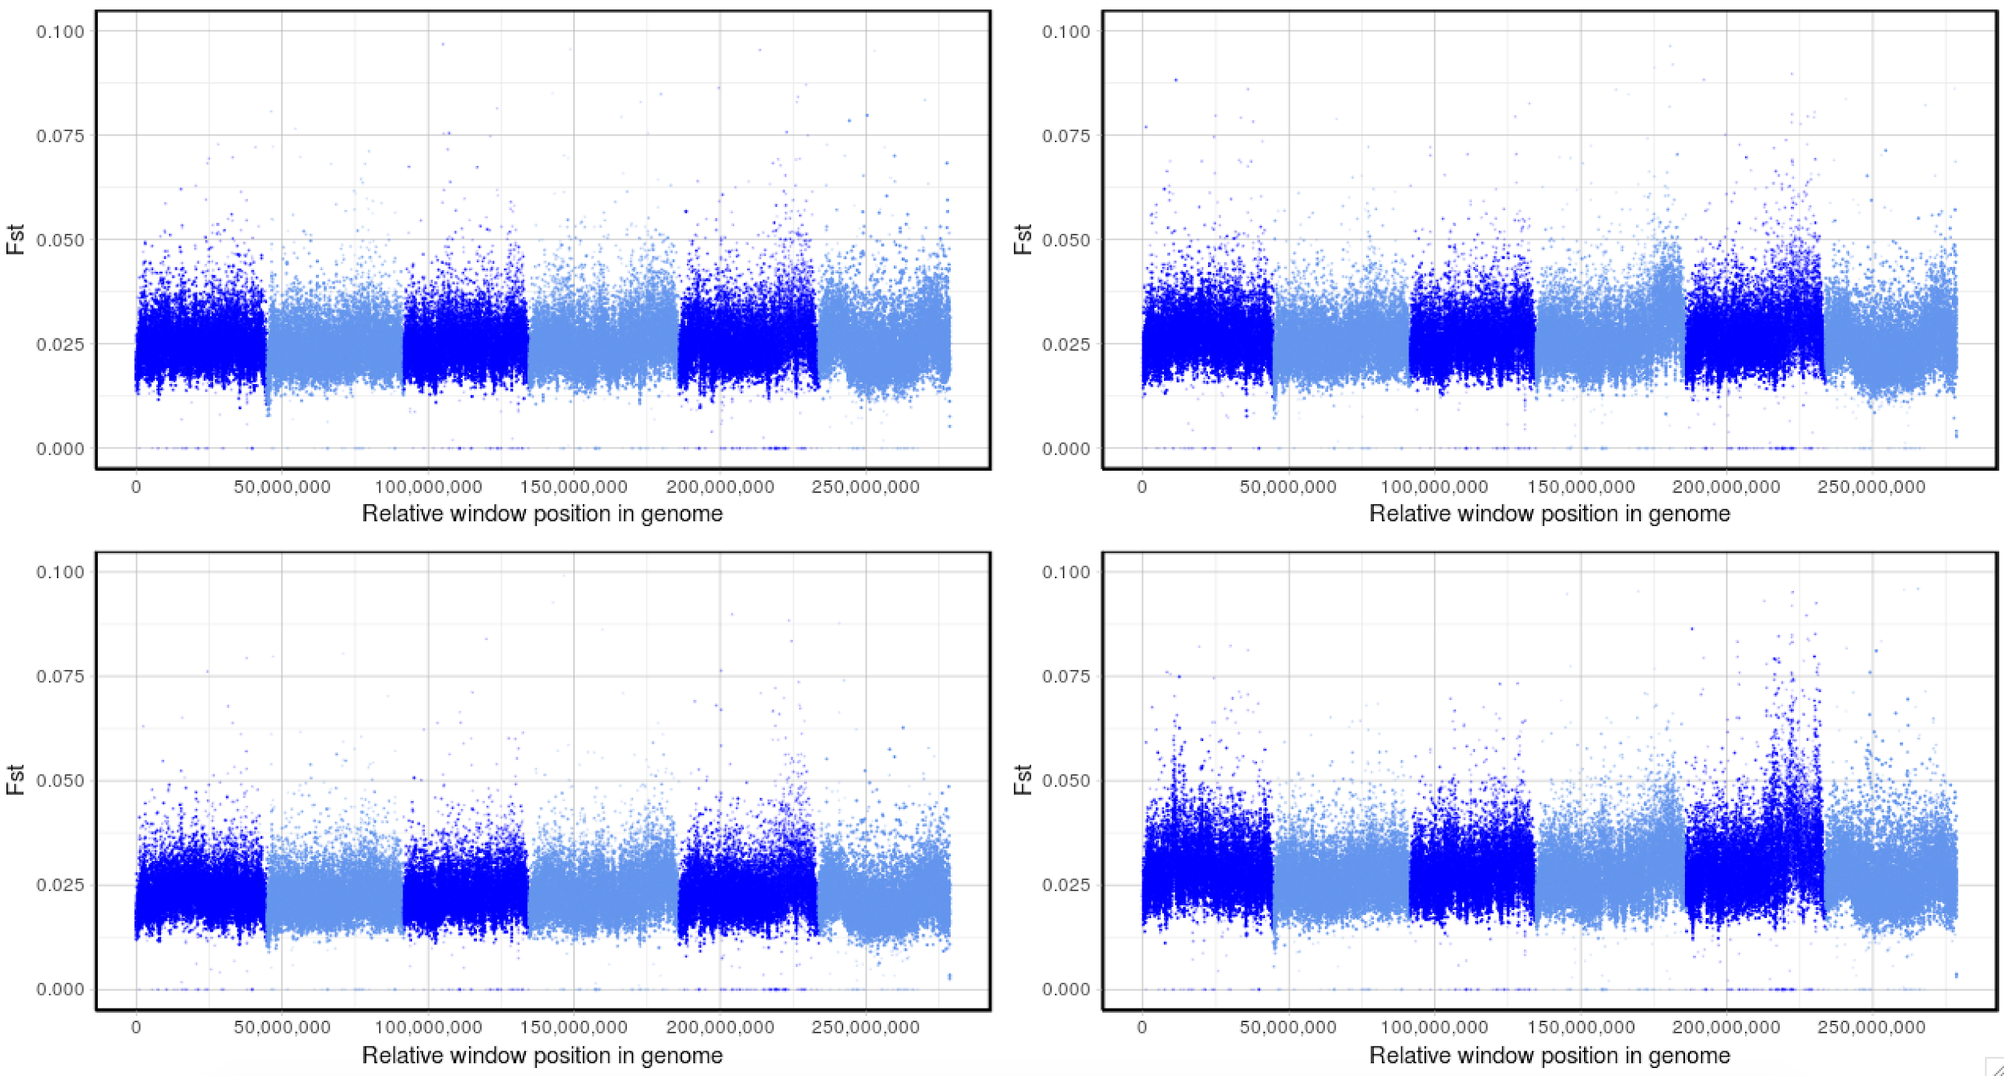
XQTL_AdvancedIntercross: F4 L3_n200 - replicate 1
Control_pre_v_0.5X
IVM_pre_v_0.5X
Control_pre_v_2X
IVM_pre_v_2X

Slide 22
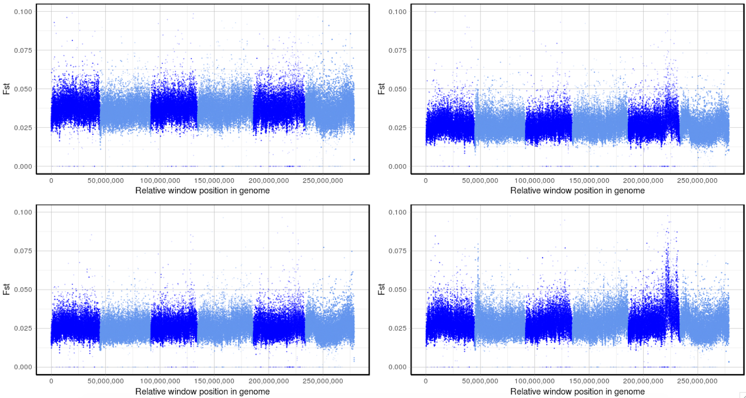
XQTL_AdvancedIntercross: F4 L3_n200 - replicate 2
Control_pre_v_0.5X
IVM_pre_v_0.5X
Control_pre_v_2X
IVM_pre_v_2X

Slide 23
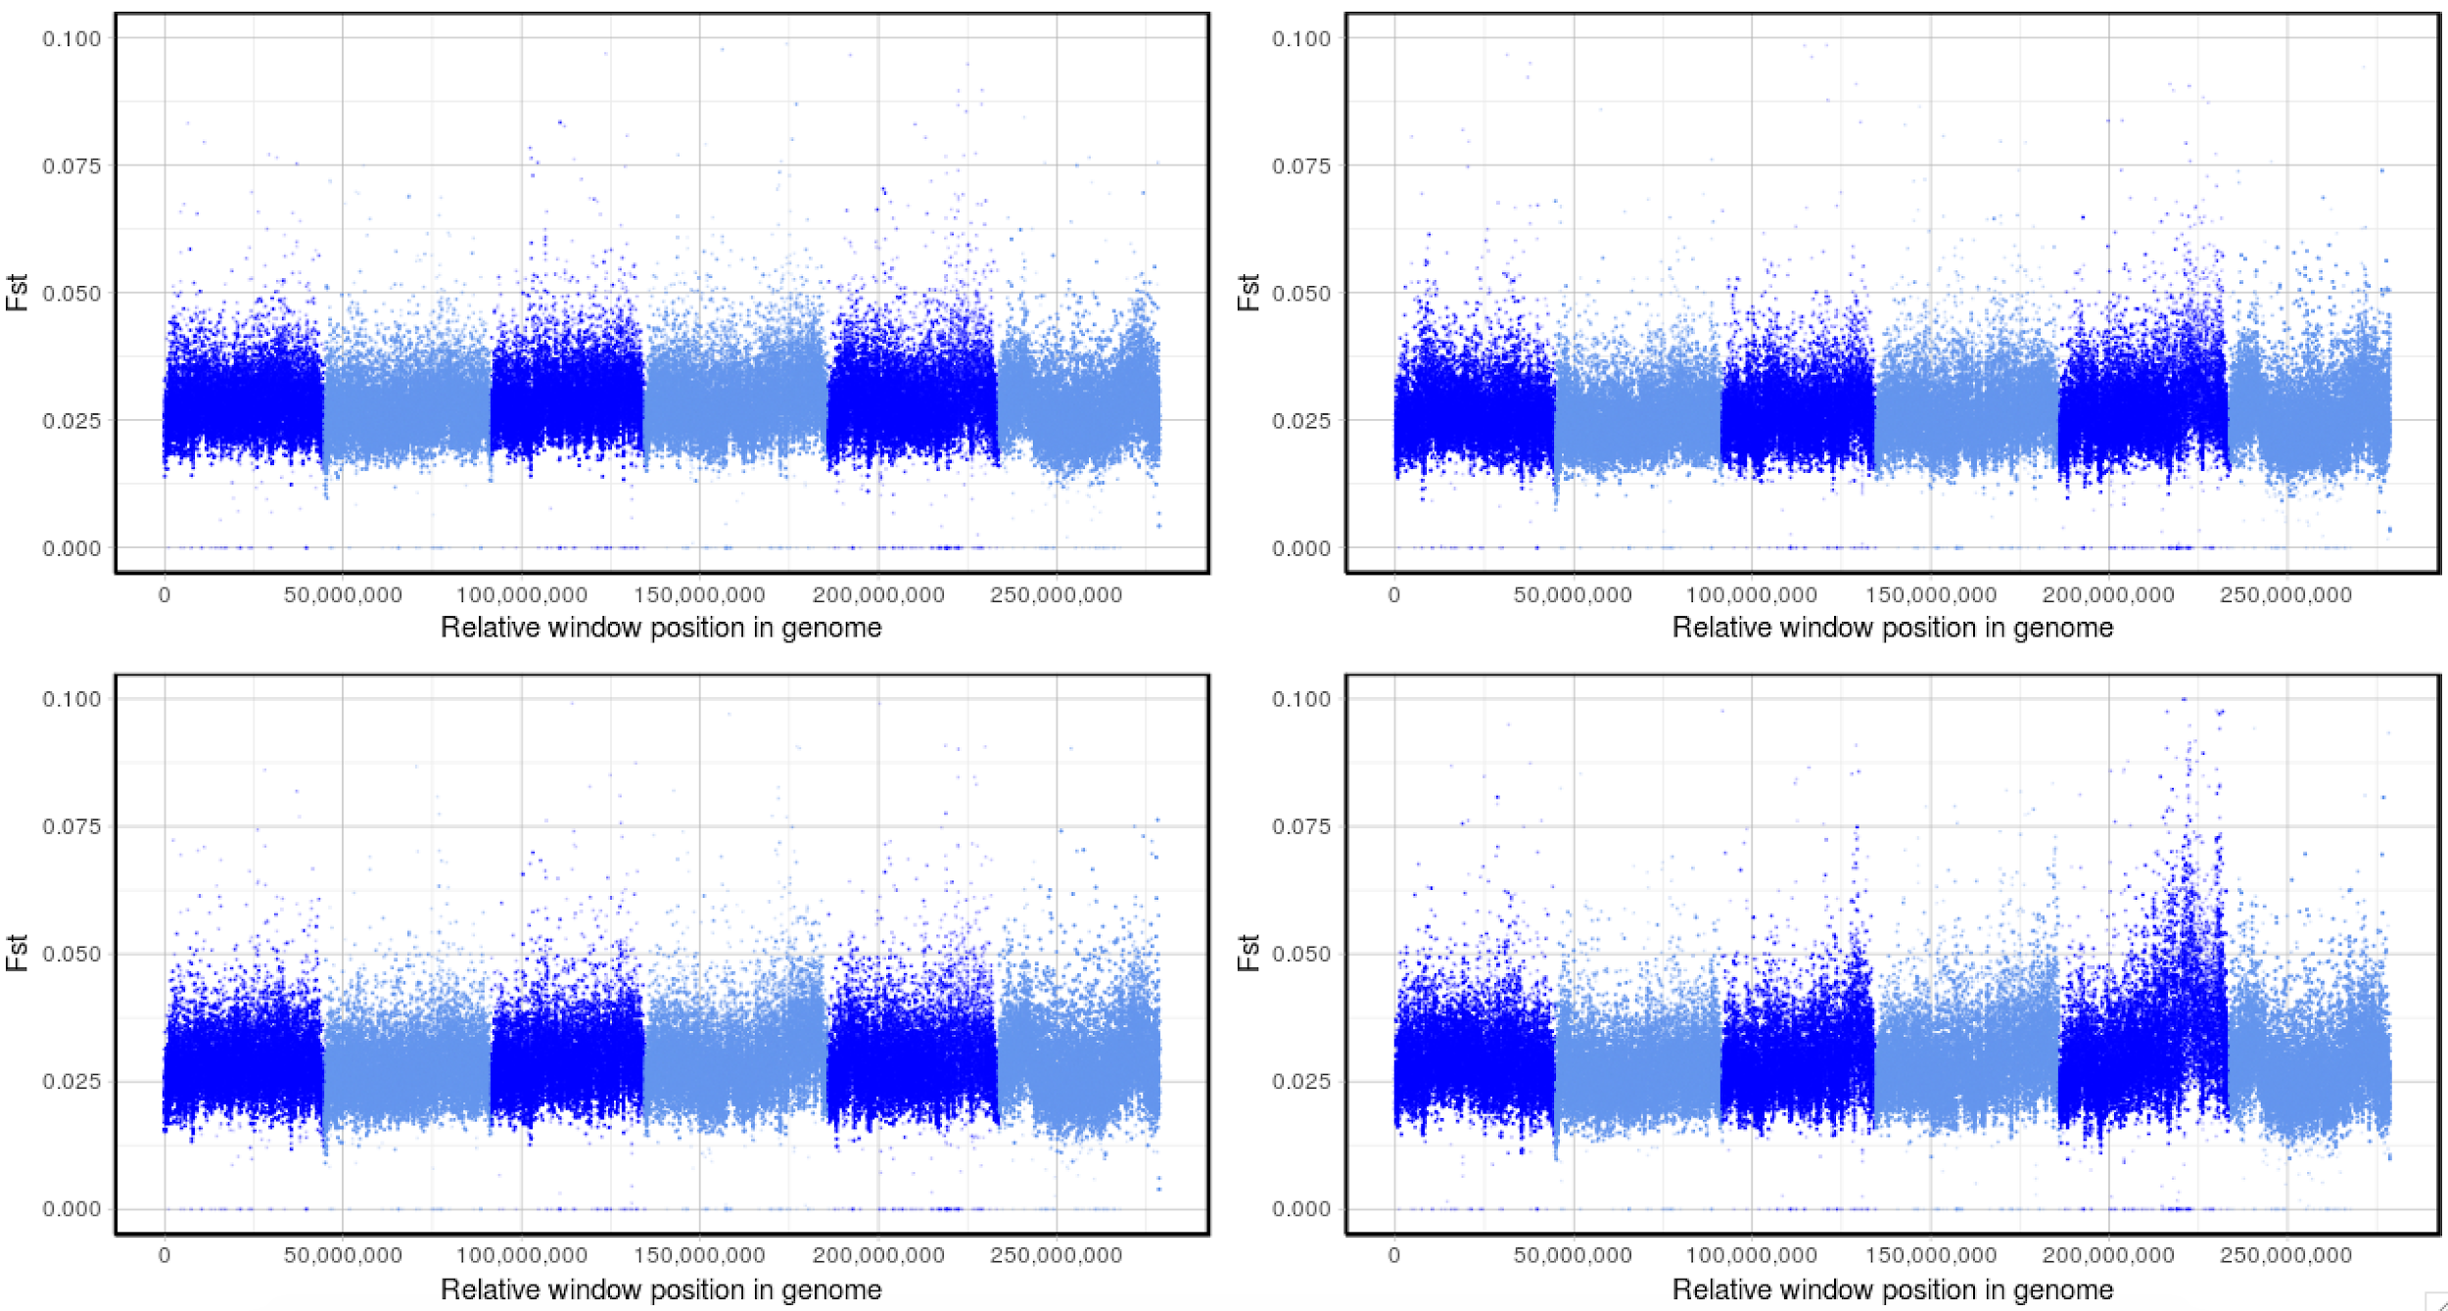
XQTL_AdvancedIntercross: F4 L3_n200 - replicate 3
Control_pre_v_0.5X
IVM_pre_v_0.5X
Control_pre_v_2X
IVM_pre_v_2X

Slide 24
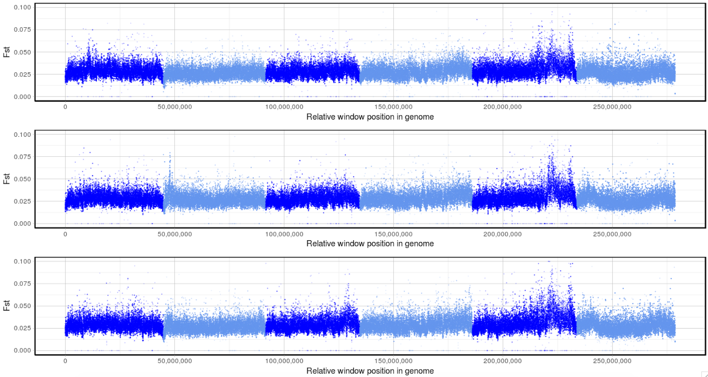
XQTL.R1
AI.R1
AI.R2
AI.R3

Slide 25
Peak prediction

Slide 26
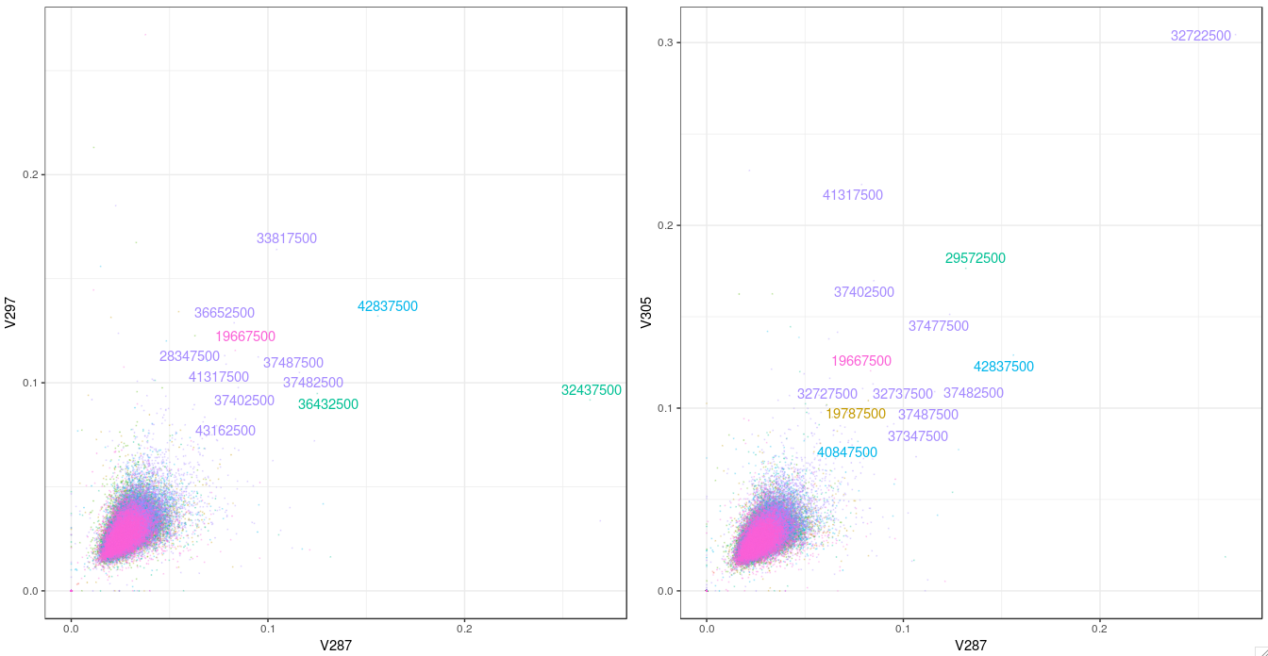
XQTL_AIntercross: F4 L3_n200 – pairwise between pre v IVM2x replicates

Slide 27
Peak prediction

Slide 28
https://www.nature.com/articles/35077011
S/T Position of variant in acr-8
Nicotinic receptor ligand-binding residues on the principal (pink) and complementary (dark blue) side are indicated
Cys-loop

Slide 29
Levamisole (LEV)-associated loci
NS mutation
(Ser168Thr)
Proposed deletion
XQTL (genetic cross)
US farms
Resistant / peak
???
Notes:
https://www.ncbi.nlm.nih.gov/pmc/articles/PMC3160419/?report=reader#!po=10.7143

Slide 30
Levamisole (LEV)-associated loci

